Slide 1
ISTD 50.001 INTRODUCTION TO INFORMATION SYSTEMS & PROGRAMMING
Fall 2018

Slide 2

Welcome back!
School starts…

Slide 3
The Team
Instructors
Ngai-Man (Man) Cheung
Norman Lee
Teaching Assistant
Sun Jiamei
HUI Yau Wai Lucas
Eric Gerard Rothstein Morris

Slide 4
Learning Objectives
Understand and be proficient and effective in Object-Oriented Programming
Understand and be proficient in design and develop large and complicated software system

Slide 5
Course Overview
14 weeks
3 cohort sessions per week (5 hours)
Bring your laptop to class

Slide 6
Course Overview
Week 1 to 7: Programming
Object oriented programming
Design principle
The emphasis is not the syntax but modern programming language design and effective programming: clear, correct, robust, and reusable code

Slide 7
Course Overview
Week 8 to 14: Complicated information systems
Android system and programming
Information System Design Project

Slide 8
Programming roadmap
Term-3 Digital World: basic programming concepts with Python
Term-4 Information systems and programming: In-depth programming and software/system design with Java
Term-5 Software construction: advance programming (e.g., concurrent programming) with Java

Slide 9
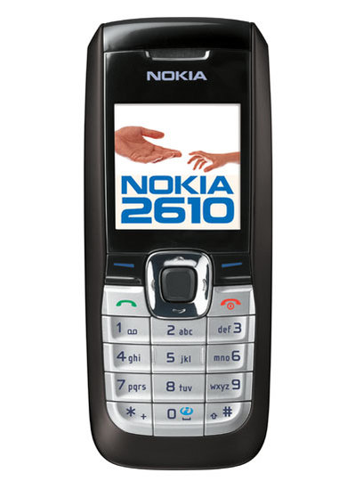

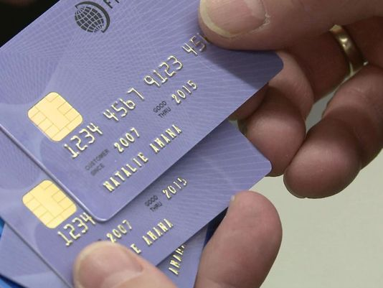
Course Overview
Since introduction in 1995:
1.1 billion desktops run Java
930 million Java Runtime Environment downloads each year
Mobile phone
Java powers set-top boxes, printers, games, car navigation systems, lottery terminals, medical devices, parking payment stations
1.4 billion Java Cards are manufactured each year
Java Programming
3 billion devices run Java (vs. 1 billion vehicles in the world)

Slide 10

Course Overview
An operating system (like Microsoft Windows 8, OS X, iOS)
For mobile devices
Has the largest installed base of all operating systems
Android smartphones had an installed base of 1.6 billion units, which was 75% of the total number of smartphones worldwide
Based on Linux kernel
Android Programming
GUI

Slide 11
Reference and Resources
Software
Java development kit (JDK):
http://www.oracle.com/technetwork/java/javase/downloads/index.html
choose the "JDK Download" there
Android Studio
https://developer.android.com/studio/
We will be using eDimension and Vocareum. Please check if you can access it
Course web-page (materials will be uploaded to there)
https://istd.sutd.edu.sg/50-001/

Slide 12
Reference and Resources
Reference Books (Copies available in SUTD library)
Introduction to Java Programming, Comprehensive Version (9th Edition) [Paperback], Y. Daniel Liang
Effective Java (2nd Edition) [Paperback], Joshua Bloch
Java Tutorial: http://docs.oracle.com/javase/tutorial/
Java API Specification: https://docs.oracle.com/javase/10/docs/api/index.html?overview-summary.html
Questions and Answers: http://stackoverflow.com/

Slide 13
Grading
2 problem sets (Week-1 to 7)
1D project (Information systems)
2D project
Mid-term and final exams
Some questions in the exams will be similar to those in homework, cohort problem and project
Mid-term Exam | 25%
Final Exam | 25%
1D Design Project | 28%
2D Project | 10%
Homework and cohort exercise | 10%
Participation | 2%

Slide 14
Quizzes
Exams: Open book, no Internet access
Mid-term exam: 2-Nov, 2018 (Friday) 2.00pm to 4.00pm (2hrs)
Final exam: 13 Dec 2018 (Thur) 9.00am to 11.00am (2hrs)
Important: Attending mid-term and final exams is a necessary condition for passing the course

Slide 15
Academic Honesty
Unless specified otherwise, all assignments, projects, quizzes and exams are to be completed by you without assistance from anyone other than the course instructors.
Please read carefully the Policies page on the course web site.
https://istd.sutd.edu.sg/50-001/policies/
We trust you a lot. Please don’t let us down.

Slide 16

Please give us feedback / suggestion during the course

